Slide 1

Accessing Database with JDBC

Slide 2
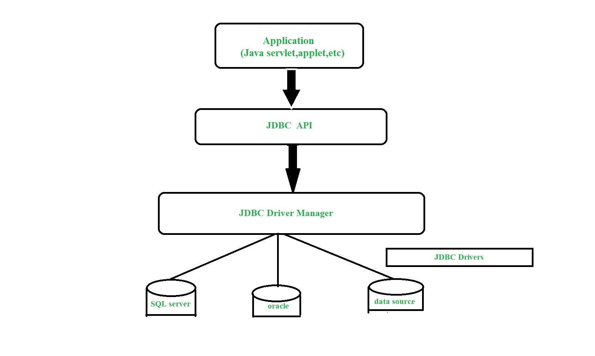

Slide 3
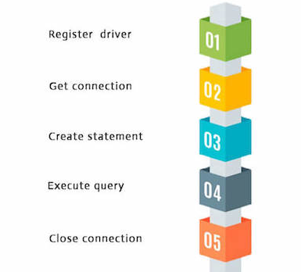
Database Connectivity

Slide 4
5th Unit completed today

